Slide 1
University Physics I, Mechanics - Lesson 5: Work and energy
January 2022– June 2022
Teacher: Dr. Paul Briard
Email: paulbriard@outlook.com
Wechat: Paulbg123
Notes:
PARLER LENTEMENT: Hello everybody. I wish you had nice vacations. Let’s continue the lecture about University Physics. Jiajie said we will have another two weeks of online lectures, and then I will have the pleasure to meet you face to face. Until I meet you in person, the text of what I say during the lecture is still written at the bellow the slide. This lesson is focused about energy and work, two very important concepts in Physics. Maybe you have already seen them a bit in high school and I will describe them deeply. I will not speak today about all of kinds of energy, but during the whole year, we will discuss about many kinds of energy.

Slide 2
Contents
1. What is the work in Physics ?
Notes:
PARLER LENTEMENT: First let’s describe the contents of the lesson. First, I will describe what is the work in physics. Of course, it is not what we call work in our daily life. The work is involved with interactions between bodies, we have described last time by forces.

Slide 3
Contents
1. What is the work in Physics ?
2. The work-kinetic energy theorem
Notes:
PARLER LENTEMENT: Then I will describe you the work-kinetic energy theorem. Certainly, you know already what is the kinetic energy which is related with the mass and the velocity of a body. During the lesson, we will see where the expression of the kinetic energy you know come from

Slide 4
Contents
1. What is the work in Physics ?
2. The work-kinetic energy theorem
3. Power associated with work
Notes:
PARLER LENTEMENT: After that, I will describe you what is the power. You already know a bit about power, for instance, the power of a car, or the power of an electrical device. Today, we will speak about power associated with the work.

Slide 5
Contents
1. What is the work in Physics ?
2. The work-kinetic energy theorem
3. Power associated with work
4. The potential energy
5. The law of conservation of energy
Notes:
PARLER LENTEMENT: And finally, I will speak you about the potential energy and how the energy can be conserved.

Slide 6

Introduction:
What happens when a smartphone falls from a high height ? And why ?
Notes:
PARLER LENTEMENT: But first, as an introduction, let’s to imagine a little experiment. What happens if a smartphone falls from a table to the ground ?

Slide 7

Result:
What happens when a smartphone falls from a high height ?
And why ?
It is involved with the gravitational force. But the gravitational force don’t break it. Gravitational force is involved with transfers of energy, the topic of this lesson.
Notes:
PARLER LENTEMENT: You know what happens. The screen of your smartphone will break and you will be very sad as this person. Why do this happens ? This is involved with the gravitational force but a gravitational force itself don’t break a smartphone, its just influence its motion. This is involved with transfer of energy between bodies. When the smartphone falls, its gain energy which a part is converted to break the screen when it reaches the ground. Transfers of energy is the topic of this lesson.

Slide 8
1. What is the work in Physics ?
Notes:
PARLER LENTEMENT: And now, we will describe what is the work, which is one kind of transfer of energy.

Slide 9
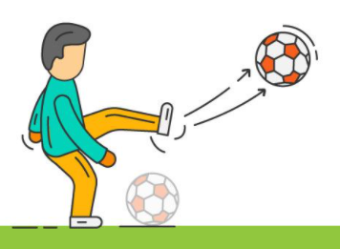
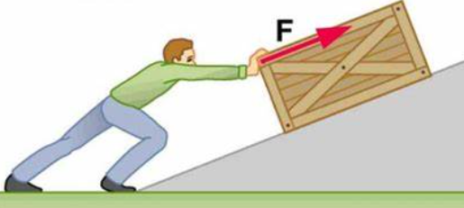
The work: Introduction
We have seen what are forces, an interaction between two bodies.
By applying a force, this person gives energy to the balloon which permit it to move.
By applying a force, this person gives energy to the box which permit it to move.
https://courses.lumenlearning.com/physics/chapter/7-1-work-the-scientific-definition/
Notes:
PARLER LENTEMENT: In the previous lesson, we have described what are forces. They are interaction between bodies and they have an effect on the motion of the bodies. When your foot touches the balloon as in the figure, you exert a force on it. And during the same time of contact between your foot and the balloon, there is a transfer of energy between you and the balloon. In the second figure is another example, where the person gives energy to the box which permits it to move it. So transfers of energy between bodies are involved with forces.

Slide 10
The work: Introduction
We have seen what are forces, an interaction between two bodies.
The work is a kind of transfer of energy between two bodies, when forces are exerted between these bodies.
Notes:
PARLER LENTEMENT: The work is a kind of transfer of energy between two bodies, when forces are exerted between these bodies. I say “a kind” because we will see later another kind of transfer of energy I don’t describe today.

Slide 11
The work: Introduction
We have seen what are forces, an interaction between two bodies.
The work is a kind of transfer of energy between two bodies, when forces are exerted between these bodies.
For each force exerted on a body, there is an associated work
There is a total work associated with the net force exerted on a body.
Notes:
PARLER LENTEMENT: For each force exerted on a body, there is an associated work. Last time, we have described what is the net force, which is the sum of all the external forces exerted on a body. There is a total work associated with the net force exerted on a body.

Slide 12
The work: Introduction
We have seen what are forces, an interaction between two bodies.
The work is a kind of transfer of energy between two bodies, when forces are exerted between these bodies.
For each force exerted on a body, there is an associated work
There is a total work associated with the net force exerted on a body.
Work is related with the motion of a body: a force applied to a body could help the motion, or be resisting to the motion
Notes:
PARLER LENTEMENT: Work is also related with the motion of a body. A force applied to a body call help the motion of the body, or it can be resisting to the motion, for instance if the direction of the force is opposite to the motion, as for the case of the friction force we have described last time.

Slide 13
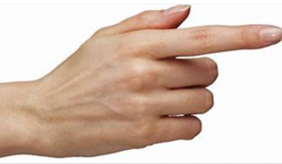
The work: Introduction
Examples:
Pushing force
box
motion
table
The pushing force helps the motion. It does a positive work.
Notes:
PARLER LENTEMENT: Now let’s see few examples. Imagine that you push a box on the table with your finger. The force you exert is directed toward the right. The motion is also directed toward the right. In that case, the force you exert on the box helps its motion. In physics, we say

Slide 14
The work: Introduction
Examples:
Pushing force
box
motion
table
The pushing force helps the motion
Pushing force
Pushing force
box
motion
table
The pushing force at the left help the motion but the pushing force at the right is opposite to this motion. The pushing force at the right does a negative work.
Notes:
PARLER LENTEMENT: But now, imagine somebody at the other side of the box push it also. You push stronger toward the right, so the box moves toward the right. But the second pushing force directed toward the left don’t help this motion toward the right. It is opposite to the motion on the box. In physics, we say, it It does a negative work.

Slide 15


The work: Introduction
Examples:
normal force $\vec{n}$
Pushing force
box
motion
table
Weight $\vec{w}$
Here, the weight (gravitational force on the box) and the normal force either help the motion neither are opposed to the motion.
They don’t do work !
Notes:
PARLER LENTEMENT: I have described the pushing forces. But what about the normal forces and the weight of the box. You can see that here, they are directed in directions perpendicular to the motion of the box. They don’t help the motion and they are not opposite to the motion. In physics, we say they don’t do work.

Slide 16

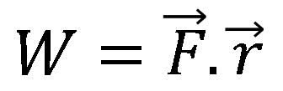
The work done by a constant force during a straight-line displacement
Constant pushing force
$$\vec{r}$$
The work done by a constant force $\vec{F}$ during a straight-line displacement $\vec{r}$ at constant velocity:
$$W=\vec{F}.\vec{r}$$
Notes:
PARLER LENTEMENT: So here is a first mathematical expression of the work. You can see this expression is very simple and describe the work done by a constant force F during a straight line displacement between two position, described by the vector r. The work done by the force F is the scalar product between the force and the displacement.

Slide 17

The work done by a constant force during a straight-line displacement
Constant pushing force
$$\vec{r}$$
The work done by a constant force $\vec{F}$ during a straight-line displacement $\vec{r}$ at constant velocity:
$$W=\vec{F}.\vec{r}$$
$$W=F.r$$
If the force and the displacement has same direction:
Notes:
PARLER LENTEMENT: If the constant force and the displacement have same directions, the work done by the force during the displacement is simply the production between their magnitude.

Slide 18



The work done by a constant force during a straight-line displacement
rope
$$\vec{F}$$
$$\vec{F}$$
Constant pulling force
$$\vec{r}$$
The work done by a constant force $\vec{F}$ during a straight-line displacement $\vec{r}$ at constant velocity:
$$W=\vec{F}.\vec{r}$$
Important to remember
$$W=F.r.\cos{θ}$$
where the angle $θ=\left(\vec{F},\vec{r}\right)$
Notes:
PARLER LENTEMENT: But in most of case, the direction of the displacement is not the direction of the force exerted. Here is an example where a rope exert a tension force on the box. Here the direction of force exerted is not the displacement. The work done by the constant force is the product between the magnitude of the constant force F, the displacement r, and the cosine of the angle theta, which is the angle the force and the displacement.

Slide 19
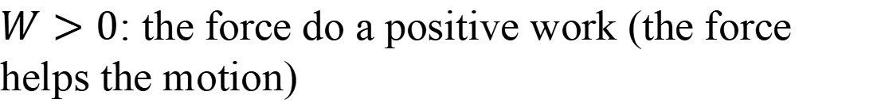
The work done by a constant force during a straight-line displacement
$$W=\vec{F}.\vec{r}$$
$W>0$: the force do a positive work (the force helps the motion)
Notes:
PARLER LENTEMENT: Depending to the direction of the force and the displacement, we consider 3 kinds of cases. If the work is positive, its means the force help the motion. We say it does a positive work.

Slide 20
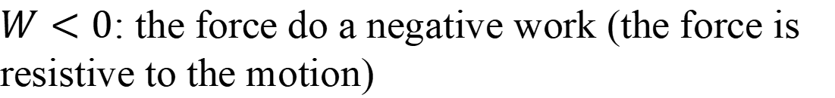
The work done by a constant force during a straight-line displacement
$$W=\vec{F}.\vec{r}$$
$W>0$: the force do a positive work (the force helps the motion)
$W<0$: the force do a negative work (the force is resistive to the motion)
Notes:
PARLER LENTEMENT: If the work is negative, the force is resistive to the motion. We say the force does a negative work.

Slide 21
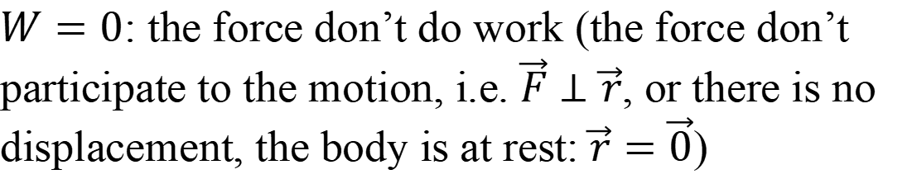
The work done by a constant force during a straight-line displacement
$$W=\vec{F}.\vec{r}$$
$W>0$: the force do a positive work (the force helps the motion)
$W<0$: the force do a negative work (the force is resistive to the motion)
$W=0$: the force don’t do work (the force don’t participate to the motion, i.e. $\vec{F}⊥\vec{r}$, or there is no displacement, the body is at rest: $\vec{r}=\vec{0}$)
Notes:
PARLER LENTEMENT: And finally, if the work equals zero, the force don’t help the motion and the force isn’t resistive to the motion. In this particular case, the forces and the displacement are directed in perpendicular directions. But there is another possibility. When a force is exerted on a body at rest, its displacement is zero, and then the work done by the force is also zero. In these case, we say “the force doesn’t do work”.

Slide 22
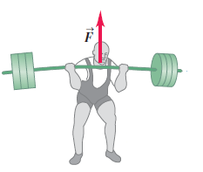
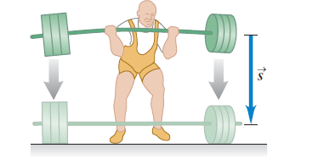
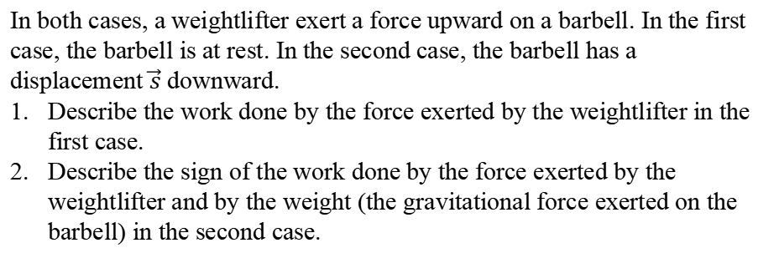


Ex: work on a barbell (2 minutes)
1st case:
$$\vec{F}$$
2nd case:
$$\vec{w}$$
Barbell at rest
In both cases, a weightlifter exert a force upward on a barbell. In the first case, the barbell is at rest. In the second case, the barbell has a displacement $\vec{s}$ downward.
Describe the work done by the force exerted by the weightlifter in the first case.
Describe the sign of the work done by the force exerted by the weightlifter and by the weight (the gravitational force exerted on the barbell) in the second case.
Notes:
PARLER LENTEMENT: Here is a little exercise. A weightlifter exert a force upward on a barbell. In the first case, the barbell is at rest. In the second case, the barbell has a displacement described by vector s, the displacement is downward. Please to describe the work done on barbell by the pushing force when it is at rest. Then, please to describe the sign of the work done by the pushing force and by the weight on the barbell when the barbell has the displacement s between two positions.

Slide 23
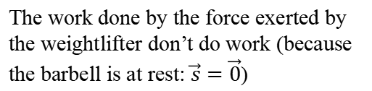

Ex: work on a barbell (2 minutes)
1st case:
2nd case:
Barbell at rest
The work done by the force exerted by the weightlifter don’t do work (because the barbell is at rest: $\vec{s}=\vec{0}$)
$$W_{F}=0$$
Notes:
PARLER LENTEMENT: In the first case, the barbell is at rest. Thus, the work done by the force exerted on it is zero because of the expression of the work, which depends on the displacement. The barbell at rest has zero displacement.

Slide 24


Ex: work on a barbell (2 minutes)
1st case:
$$\vec{F}$$
2nd case:
$$\vec{w}$$
Barbell at rest
The work done during this displacement by the force exerted by the weightlifter on the barbell is negative (opposed to the motion)
The work done by the force exerted by the weightlifter don’t do work (because the barbell is at rest: $\vec{s}=\vec{0}$)
$$W_{F}<0$$
The work done by the weight of the barbell is positive (gravitational force help the motion)
$$W_{F}=0$$
$$W_{w}>0$$
Notes:
PARLER LENTEMENT: In the second situation, the barbell has a displacement downward. The weight w help the motion of the barbell. It does a positive work. The force exerted by the weightlifter is upward, thus it is resistive to the motion. The force exerted by him does a negative work.

Slide 25

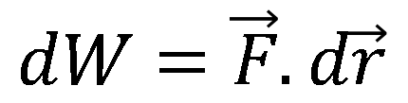
The infinitesimal work done by a force during infinitesimal displacement
rope
$$\vec{F}$$
force
$$d\vec{r}$$
The infinitesimal work done by a force $\vec{F}$ (could be constant or not constant) during an infinitesimal displacement d$\vec{r}$
$$dW=\vec{F}.d\vec{r}$$
Notes:
PARLER LENTEMENT: Until now, we have considered a constant force exerted during a straight-line displacement. For all other situations, we will have to describe the infinitesimal work done by a force during an infinitesimal displacement. The infinitesimal work is simply the scalar product between the force and the infinitesimal displacement

Slide 26


The infinitesimal work done by a force during infinitesimal displacement
rope
$$\vec{F}$$
force
$$d\vec{r}$$
The infinitesimal work done by a force $\vec{F}$ (could be constant or not constant) during an infinitesimal displacement $d\vec{r}$
$$dW=\vec{F}.d\vec{r}$$
$$dW=F.dr.\cos{θ}$$
where the angle $θ=\left(\vec{F},d\vec{r}\right)$
Notes:
PARLER LENTEMENT: The infinitesimal work is then the production between the magnitude of the force, the magnitude of the infinitesimal displacement and the cosine of the angle between their directions.

Slide 27
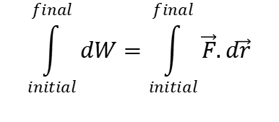

The work done by a force during a displacement between two positions is then:
$$\vec{F}$$
$$\vec{F}$$
$$d\vec{r}$$
$$\vec{F}$$
$$d\vec{r}$$
$$d\vec{r}$$
$$\int_{initial}^{final}{dW}=\int_{initial}^{final}{\vec{F}.d\vec{r}}$$
final position
Initial position
trajectory
Notes:
PARLER LENTEMENT: Imagine a body has a certain initial position and a certain final position. The infinitesimal displacement and the force exerted on the body change during the motion. If we sum all of the infinitesimal work together during the motion from the initial position to the final solution we obtain the expression at the right.

Slide 28

The work done by a force during a displacement between two positions is then:
$$\vec{F}$$
$$\vec{F}$$
$$d\vec{r}$$
$$\vec{F}$$
$$d\vec{r}$$
$$d\vec{r}$$
$$\int_{initial}^{final}{dW}=\int_{initial}^{final}{\vec{F}.d\vec{r}}$$
final position
Initial position
trajectory
Work done by the force $\vec{F}$ during the displacement from an initial position to a final position
$$W=\int_{i}^{f}{\vec{F}.d\vec{r}}$$
Important to remember
(i: initial position
f: final position)
Here the force could be not constant, and the displacement could be not straight line
Notes:
PARLER LENTEMENT: And finally, we obtain the expression of the work done by the force F on the body between two positions. Here the force could be not constant, and the displacement could be not a straight-line displacement. This expression will be useful so please to remember it.

Slide 29

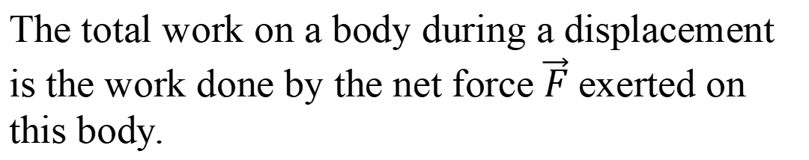
Total work
The total work on a body during a displacement is the work done by the net force $\vec{F}$ exerted on this body.
$$W_{tot}=\int{\vec{F}.d\vec{r}}$$
Notes:
PARLER LENTEMENT: The total work is the work done by the net force. It is described in the same way than previously.

Slide 30
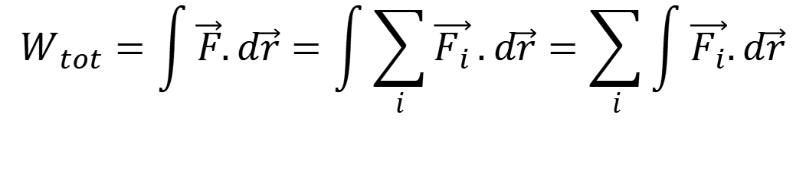
Total work
The total work on a body during a displacement is the work done by the net force $\vec{F}$ exerted on this body.
$$W_{tot}=\int{\vec{F}.d\vec{r}}=\int{\sum_{i}{\vec{F_{i}}}}.d\vec{r}=\sum_{i}{\int{\vec{F_{i}}.d\vec{r}}}$$
Notes:
PARLER LENTEMENT: We know that the net force is the sum of the external forces exerted on the body. These forces exerted on the body are named F_i. And we can put the symbol of the sum outside the integral, we obtain the expression at the right of the total work. You can see that it is involved with the work done by each of the forces exerted on the body.

Slide 31

Total work
The total work on a body during a displacement is the work done by the net force $\vec{F}$ exerted on this body.
$$W_{tot}=\int{\vec{F}.d\vec{r}}=\int{\sum_{i}{\vec{F_{i}}}}.d\vec{r}=\sum_{i}{\int{\vec{F_{i}}.d\vec{r}}}$$
$$W_{tot}=\sum_{i}{W_{i}}$$
Important to remember
The work done by the net force is the sum of the works done by all the forces exerted on the body.
Notes:
PARLER LENTEMENT: Thus, the total work, or “work done by the net force” is simply the sum of all the works done by the forces exerted to the body. This expression will be useful to describe the work done by the forces exerted and by the net force.

Slide 32
2. The work-kinetic energy theorem
Notes:
PARLER LENTEMENT: That’s all for the description of the work. Now, let’s describe the work-kinetic energy theorem.

Slide 33
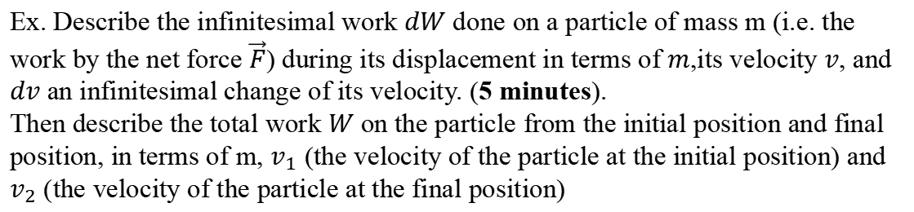
Introduction
$$\vec{F}$$
$$\vec{v}$$
$$\vec{F}$$
$$d\vec{r}$$
$$\vec{F}$$
$$d\vec{r}$$
$$d\vec{r}$$
final position
Initial position
trajectory
Ex. Describe the infinitesimal work $dW$ done on a particle of mass m (i.e. the work by the net force $\vec{F}$) during its displacement in terms of $m$,its velocity $v$, and $dv$ an infinitesimal change of its velocity. (5 minutes).
Then describe the total work $W$ on the particle from the initial position and final position, in terms of m, $v_{1}$ (the velocity of the particle at the initial position) and $v_{2}$ (the velocity of the particle at the final position)
Notes:
PARLER LENTEMENT:

Slide 34




Introduction
$$dW=\vec{F}.d\vec{r}$$
$${\vec{v}}_{2}$$
$$d\vec{r}$$
Net force on the particle
$$dW=m\vec{a}.d\vec{r}$$
$${\vec{v}}_{1}$$
Notes:
PARLER LENTEMENT: First we know the expression of the infinitesimal work done by the net force. By using the Newton second law, we can describe the infinitesimal work in terms of mass and acceleration of the particle.

Slide 35



Introduction
$$dW=\vec{F}.d\vec{r}$$
$${\vec{v}}_{2}$$
$$d\vec{r}$$
Net force on the particle
$$dW=m\vec{a}.d\vec{r}$$
$$dW=ma\left|d\vec{r} \right|\cos{θ}$$
$${\vec{v}}_{1}$$
$$dW=ma_{t}\left|d\vec{r} \right|$$
Tangential acceleration: $a_{t}=\operatorname{acos}{θ}$
Notes:
PARLER LENTEMENT: Then, we can describe the infinitesimal work done by the net force is terms of the tangential acceleration of the particle a_t. We have described it few weeks ago. It is the tangential component of the acceleration. Take care about the infinitesimal displacement, we write here its magnitude. The work is a scalar so at the right of the equation we should also have a scalar.

Slide 36




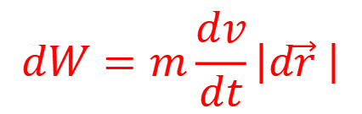
Introduction
$$dW=\vec{F}.d\vec{r}$$
$${\vec{v}}_{2}$$
$$d\vec{r}$$
Net force on the particle
$$dW=m\vec{a}.d\vec{r}$$
$$dW=ma\left|d\vec{r} \right|\cos{θ}$$
$${\vec{v}}_{1}$$
$$dW=ma_{t}\left|d\vec{r} \right|$$
Tangential acceleration: $a_{t}=\operatorname{acos}{θ}$
$$dW=m\frac{dv}{dt}\left|d\vec{r} \right|$$
Notes:
PARLER LENTEMENT: We know the expression of the tangential acceleration, it is the time derivative of the velocity.

Slide 37


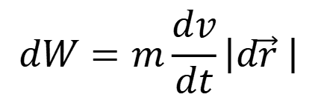
Introduction
$$dW=\vec{F}.d\vec{r}$$
$${\vec{v}}_{2}$$
$$d\vec{r}$$
Net force on the particle
$$dW=m\vec{a}.d\vec{r}$$
$$dW=ma\left|d\vec{r} \right|\cos{θ}$$
$${\vec{v}}_{1}$$
$$dW=ma_{t}\left|d\vec{r} \right|$$
Tangential acceleration: $a_{t}=\operatorname{acos}{θ}$
$$dW=m\frac{dv}{dt}\left|d\vec{r} \right|$$
and
$$\left|d\vec{r} \right|=vdt$$
$$dW=mvdv$$
Notes:
PARLER LENTEMENT: And we know that the velocity is the time derivative of the displacement. Then, we obtain the expression of the infinitesimal work done by the net force.

Slide 38


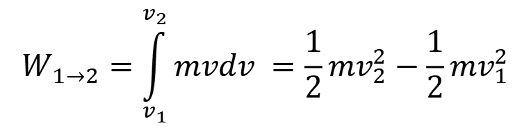
Introduction
The infinitesimal work done by the net force during the displacement $d\vec{r}$ is
$${\vec{v}}_{2}$$
$$d\vec{r}$$
$$dW=mvdv$$
$${\vec{v}}_{1}$$
The total work done on the particle during the displacement from initial position 1 to final position 2 is:
$$W_{1→2}=\int_{v_{1}}^{v_{2}}{mvdv }=\frac{1}{2}mv_{2}^{2}−\frac{1}{2}mv_{1}^{2}$$
You don’t need to remember the demonstration but you must remember this result.
Notes:
PARLER LENTEMENT: To describe the total work, we just have to sum all of the infinitesimal work in an integral, and we obtain the following expression. It doesn’t matter if you don’t remember this demonstration but you should remember this result because it is the work-kinetic energy theorem.

Slide 39

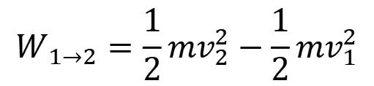
The work-kinetic energy theorem
$${\vec{v}}_{2}$$
$$W_{1→2}=\frac{1}{2}mv_{2}^{2}−\frac{1}{2}mv_{1}^{2}$$
$$d\vec{r}$$
$$W_{1→2}=E_{k,2}−E_{k,1}=∆E_{k}$$
$${\vec{v}}_{1}$$
Notes:
PARLER LENTEMENT: Here is the mathematical expression of the work-kinetic energy theorem. The work done by the net force between two positions is the also the change of kinetic energy of the particle.

Slide 40
The work-kinetic energy theorem
$${\vec{v}}_{2}$$
$$W_{1→2}=\frac{1}{2}mv_{2}^{2}−\frac{1}{2}mv_{1}^{2}$$
$$d\vec{r}$$
$$W_{1→2}=E_{k,2}−E_{k,1}=∆E_{k}$$
$${\vec{v}}_{1}$$
The total work on a body done by external forces during a displacement between two positions equals the change of kinetic energy of the body.
Notes:
PARLER LENTEMENT: And here is the sentence corresponding to these expressions: The total work on a body done by external forces during a displacement between two positions equals the change of kinetic energy of the body.

Slide 41

The work-kinetic energy theorem
$${\vec{v}}_{2}$$
$$W_{1→2}=\frac{1}{2}mv_{2}^{2}−\frac{1}{2}mv_{1}^{2}$$
$$d\vec{r}$$
$$W_{1→2}=E_{k,2}−E_{k,1}=∆E_{k}$$
$${\vec{v}}_{1}$$
The total work on a body done by external forces during a displacement between two positions equals the change of kinetic energy of the body.
Expression of the kinetic energy:
$$E_{k}=\frac{1}{2}mv^{2}$$
Notes:
PARLER LENTEMENT: We deduce from the work-kinetic energy theorem the expression of the kinetic energy of a body. It is the half of the mass multiplied by the quare of its velocity.

Slide 42

The work is a transfer of energy
$$W_{1→2}=E_{k,2}−E_{k,1}=∆E_{k}$$
This expression shows that the work is a transfer of energy to one form to another form.
If the net force has done a positive work:
$$E_{k,2}>E_{k,1}$$
The kinetic energy has increased
Notes:
PARLER LENTEMENT: So the work is a kind of transfer of energy from one form to another form, where the net force exerted on the body is involved. If the net force does a positive work, the kinety energy of the body has increased.

Slide 43

The work is a transfer of energy
$$W_{1→2}=E_{k,2}−E_{k,1}=∆E_{k}$$
This expression shows that the work is a transfer of energy to one form to another form.
If the net force has done a positive work:
$$E_{k,2}>E_{k,1}$$
The kinetic energy has increased
If the net force has done a negative work:
$$E_{k,2}<E_{k,1}$$
The kinetic energy has decreased
Notes:
PARLER LENTEMENT: If the net force has done a negative work, then the kinetic energy of the body has decreased.

Slide 44

The work is a transfer of energy
$$W_{1→2}=E_{k,2}−E_{k,1}=∆E_{k}$$
This expression shows that the work is a transfer of energy to one form to another form.
If the net force has done a positive work:
$$E_{k,2}>E_{k,1}$$
The kinetic energy has increased
If the net force has done a negative work:
$$E_{k,2}<E_{k,1}$$
The kinetic energy has decreased
If the net force didn’t do work:
$$E_{k,2}=E_{k,1}$$
The kinetic energy didn’t change
Notes:
PARLER LENTEMENT: And if the net force didn’t do work. The kinetic energy didn’t change. For instance, you can imagine a body which stay at rest.

Slide 45
Rest time

Slide 46
The power
We have a seen work is done by a force during a certain time interval.
The time rate the work is done is named, “the instantaneous power”
Notes:
PARLER LENTEMENT: Now, let’s describe power associated with forces and work. The work done by a force is exerted during a certain time interval. The time rate the work is done is the instantaneous power associated with this work.

Slide 47

The power
We have a seen work is done by a force during a certain time interval.
The time rate the work is done is named, “the instantaneous power”
$$P=\frac{dW}{dt}$$
Notes:
PARLER LENTEMENT: Thus, the instantaneous power is the ratio between the infinitesimal work done during an infinitesimal time interval dt and this time interval dt.

Slide 48

The power
We have a seen work is done by a force during a certain time interval.
The time rate the work is done is named, “the instantaneous power”
$$P=\frac{dW}{dt}$$
SI unit of the power: Watt (symbol: W)
$$1 W=1 J. s^{−1}$$
Easy to remember from the expression of the power
Warning: Don’t confuse the work and the unit of power !
Notes:
PARLER LENTEMENT: The SI unit of the power is the Watt which the symbol is the W. As you can see it is easy to remember that one watt correspond to one joule per second. But take care to don’t confuse the work and the unit of power, the same letter W is used which is quite confusing.

Slide 49


The power
trajectory
Direction tangent to the trajectory
$$d\vec{r}$$
particle
$$\vec{F}$$
a force exerted on the particle
The infinitesimal work done by the force $\vec{F}$ to the particle during $dt$ is:
$$dW=Pdt=\vec{F}.d\vec{r}$$
Notes:
PARLER LENTEMENT: We can also the infinitesimal work as the product between the instantaneous power and the infinitesimal time interval dt.

Slide 50
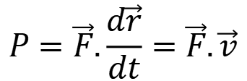
The power
trajectory
Direction tangent to the trajectory
$$d\vec{r}$$
particle
$$\vec{F}$$
a force exerted on the particle
The infinitesimal work done by the force $\vec{F}$ to the particle during $dt$ is:
$$dW=Pdt=\vec{F}.d\vec{r}$$
$$P=\vec{F}.\frac{d\vec{r}}{dt}=\vec{F}.\vec{v}$$
Notes:
PARLER LENTEMENT: And because the velocity is the ratio between the infinitesimal displacement dr dans dt, we obtain that the power is the scalar product between the force and the velocitity.

Slide 51

The power
trajectory
Direction tangent to the trajectory
$$d\vec{r}$$
particle
$$\vec{F}$$
a force exerted on the particle
The infinitesimal work done by the force $\vec{F}$ to the particle during $dt$ is:
$$dW=Pdt=\vec{F}.d\vec{r}$$
$$P=\vec{F}.\frac{d\vec{r}}{dt}=\vec{F}.\vec{v}$$
The power associated with a force acting on a particle is the scalar product between the force and the velocity vector of the particle.
$$P=\vec{F}.\vec{v}$$
Notes:
PARLER LENTEMENT: So, here we have described the power associated with a force acting on a particle.

Slide 52


The average power
Particle at time $t_{2}=t_{1}+∆t$
Particle at time $t_{1}$
particle
$$\vec{F}$$
a force exerted on the particle
Notes:
PARLER LENTEMENT: We have described what is the instantaneous power. Now, we can describe the average power associated with a force acting on a particle.

Slide 53

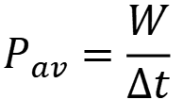
The average power
Particle at time $t_{2}=t_{1}+∆t$
Particle at time $t_{1}$
particle
$$\vec{F}$$
a force exerted on the particle
The average power done by the force $\vec{F}$ during time interval $∆t$ is:
$$P_{av}=\frac{W}{∆t}$$
work done by the force during $∆t$
Notes:
PARLER LENTEMENT: The particle moves between two times t1 and t2. The time interval between them is delta_t. the average power associated with the force F during the motion during the time interval delta _t is the work done by the force divided by the time interval delta_t.

Slide 54
The average power
Particle at time $t_{2}=t_{1}+∆t$
Particle at time $t_{1}$
particle
$$\vec{F}$$
a force exerted on the particle
The average power done by the force $\vec{F}$ during time interval $∆t$ is:
$$P_{av}=\frac{W}{∆t}$$
work done by the force during $∆t$
Warning: $P=\vec{F}.\vec{v}=dW/dt$ is an instantaneous power, corresponding to $∆t→0$.
Notes:
PARLER LENTEMENT: Take care to don’t confuse the average power and the instantaneous power. We speak about instantaneous power if the time interval is infinitesimal.

Slide 55
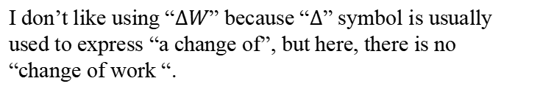
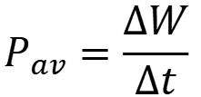
Disambiguation
Average power is noticed in some references as follows:
$$P_{av}=\frac{∆W}{∆t}$$
I don’t like using “$∆W$” because “$∆$” symbol is usually used to express “a change of”, but here, there is no “change of work “.
Notes:
PARLER LENTEMENT: Take care that sometimes, you can find book where the average power is described as follows. But I don’t like this expression because the symbol delta is used to express “a change of”. But here, there is no “change of work”, there is a certain amount of work done by a force.

Slide 56
Disambiguation
Average power is noticed in some references as follows:
In any cases, take care that work is not a kind of energy, it is a kind of transfer of energy. “A change of work” is meaningless. “An amount of work” is meaningful.
$$P_{av}=\frac{∆W}{∆t}$$
I don’t like using “$∆W$” because “$∆$” symbol is usually used to express “a change of”, but here, there is no “change of work “.
Notes:
PARLER LENTEMENT: And take care also, that in any cases, to say “a change of work” is meaningless. The work is not a kind of energy. The work is a kind of transfer of energy.

Slide 57
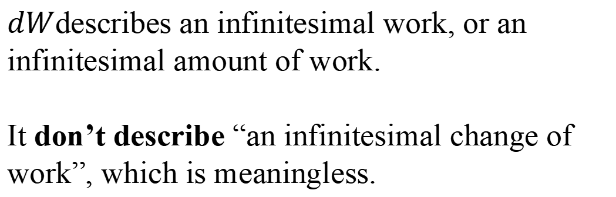

Disambiguation
About $dW$
$dW$describes an infinitesimal work, or an infinitesimal amount of work.
It don’t describe “an infinitesimal change of work”, which is meaningless.
Notes:
PARLER LENTEMENT: And about dW, it describes an infinitesimal work or an infinitesimal amount of work done by a force. It don’t describe an infinitesimal change of work, because this is meaningless.

Slide 58
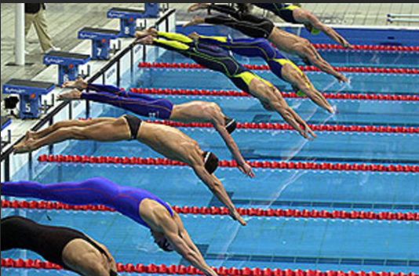
Potential energy and kinetic energy
http://www.timetoast.com/timelines/olympic-swimming
During his jump, the diver get kinetic energy (related with its motion).
Where the kinetic energy of the diver come from ?
Notes:
PARLER LENTEMENT: I have described you the work and the kinetic energy. Now, let’s describe the potential energy. When a diver jump in water, he get a certain kinetic energy. Where the kinetic energy of the diver come from ?

Slide 59
Potential energy and kinetic energy
http://www.timetoast.com/timelines/olympic-swimming
During his jump, the diver get kinetic energy (related with its motion).
Where the kinetic energy of the diver come from ?
A potential energy has been transformed in kinetic energy !
Notes:
PARLER LENTEMENT: The kinetic energy come from the potential energy the diver had. A potential energy has been transformed in kinetic energy during the motion of the diver.

Slide 60
Potential energy and kinetic energy
http://www.timetoast.com/timelines/olympic-swimming
During his jump, the diver get kinetic energy (related with its motion).
Where the kinetic energy of the diver come from ?
A potential energy has been transformed in kinetic energy !
A famous sentence of Antoine Lavoisier (1743-1794) is “Nothing is lost, nothing is created, everything is transformed”. This is true for energy.
Notes:
PARLER LENTEMENT: Maybe you know this famous sentence of Antoine Lavoisier “Nothing is lost, nothing is created, everything is transformed”. This is true for energy. Energy is not lost or created. It is just transformed from one kind to another kind.

Slide 61
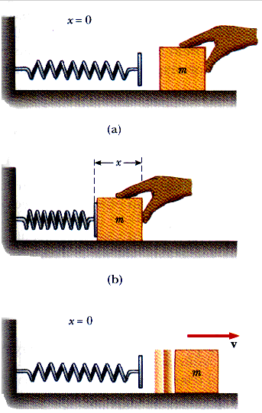
Other examples where potential energy is stored and then transformed in kinetic energy
http://www.ux1.eiu.edu/~cfadd/1350/08PotEng/Images/8.2.gif
Notes:
PARLER LENTEMENT: There is not only one kind of potential energy. In the previous slide, the potential energy was related with the gravitational force exerted on the diver. At the left, a block is pushed toward the left where there is a spring. The spring is then contracted, and if we release the block, it will move toward the right. Here the potential energy which is converted in kinetic energy is an elastic potential energy.

Slide 62
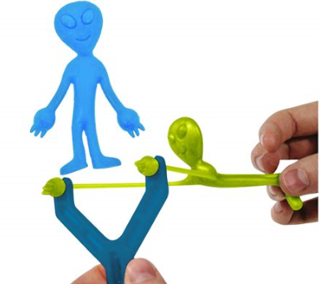
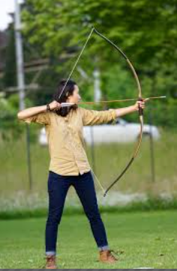
Other examples where potential energy is stored and then transformed in kinetic energy
http://www.promobo.fr/set-3-accessoires-jouet-fronde-catapulte-alien-volant-fluo.html
http://www.ux1.eiu.edu/~cfadd/1350/08PotEng/Images/8.2.gif
https://pxhere.com/fr/photo/725187
Notes:
PARLER LENTEMENT: Here are two other examples where elastic potential energy is involved. At the middle, we give elastic potential energy to the arrow, by using the bow. At the right is another example where elastic potential energy gained by the toy.

Slide 63
There are two main kinds of potential energy
The gravitational potential energy, related with gravitational forces
Notes:
PARLER LENTEMENT: So, for the moment, we will consider two main kinds of potential energy. One potential energy is related with the gravitational forces and is named gravitational potential energy.

Slide 64
There are two main kinds of potential energy
The gravitational potential energy, related with gravitational forces
The elastic potential energy (a body, for instance a spring, is elastic if it returns to its original shape and size after it has been deformed)
(There are other kinds, they will be not discussed in this lecture)
Notes:
PARLER LENTEMENT: The second kind is the elastic potential energy. We speak about in body, as a spring which is elastic, the body returns to its original shape and size after a deformation. The deformation of the bow, for instance.

Slide 65
The elastic potential energy
Notes:
PARLER LENTEMENT: Now I will give you more details about the elastic potential energy.

Slide 66
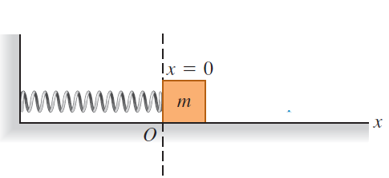

Introduction
$$x$$
$$m$$
A block of mass $m$is attached to a spring. At position x=0, the spring is at equilibrium (neither stretched nor compressed)
Notes:
PARLER LENTEMENT: In this figure a block is attached to a spring. The equilibrium position where the spring is neither stretched nor compressed is the position x=0. We define the position x of the block as the x-coordinate of its left size. At this position of equilibrium, there is no spring force exerted on the block.

Slide 67

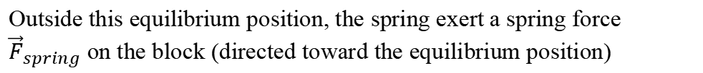
Introduction
$$x$$
$$m$$
A block of mass $m$is attached to a spring. At position x=0, the spring is at equilibrium (neither stretched nor compressed)
Outside this equilibrium position, the spring exert a spring force ${\vec{F}}_{spring}$ on the block (directed toward the equilibrium position)
$$F_{spring }=\left|k\left(x−x_{0}\right)\right|=\left|kx \right|$$
where $x_{0}$ is the equilibrium position (here $x_{0}=0$), $k$ is the spring coefficient.
Notes:
PARLER LENTEMENT: But outside the position of equilibrium, if we move the block along the x-axis with the hand, for instance, there is a spring force exerted on the block. The magnitude of this force is proportional to the distance from equilibrium x minus x0. In this example x0 =0 correspond to the position of equilibrium. The constant k is named the spring constant.

Slide 68


Introduction
$${\vec{F}}_{spring}$$
$$x$$
$$m$$
A block of mass $m$is attached to a spring. At position x=0, the spring is at equilibrium (neither stretched nor compressed)
Outside this equilibrium position, the spring exert a spring force ${\vec{F}}_{spring}$ on the block (directed toward the equilibrium position)
$$F_{spring }=\left|k\left(x−x_{0}\right)\right|=\left|kx \right|$$
where $x_{0}$ is the equilibrium position (here $x_{0}=0$), $k$ is the spring coefficient.
$x$-component of the spring force:
$$F_{spring,x }=−k\left(x−x_{0}\right)=−kx$$
Notes:
PARLER LENTEMENT: We can also describe the spring force by its x-component. It is minus k x, here. In this example, the block is at the right of the equilibrium position. The x-position is positive and the spring force is directed toward the left, thus the x-component of the spring force is negative.

Slide 69
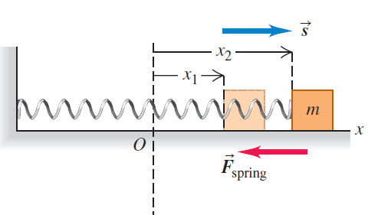
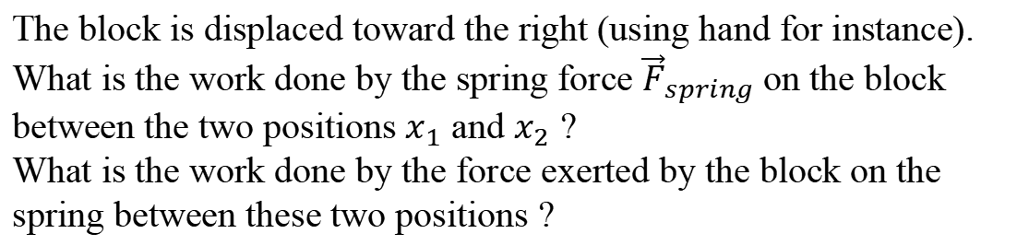
Ex. Work done by the spring force (5 minutes)
$$\vec{r}$$
The block is displaced toward the right (using hand for instance). What is the work done by the spring force ${\vec{F}}_{spring}$on the block between the two positions $x_{1}$ and $x_{2}$ ?
What is the work done by the force exerted by the block on the spring between these two positions ?
Notes:
PARLER LENTEMENT: Here is a little exercise about the spring force. The block is move from coordinate x 1 to coordinate x2, which is described by the displacement r. Please to describe the work done by the spring force between these positions. Please also to describe what is the work done by the block one the spring.

Slide 70

Ex. Work done by the spring force (5 minutes)
$$\vec{r}$$
Infinitesimal work done by the spring on the block during its displacement $\vec{r}$ is:
$$dW={\vec{F}}_{spring}.d\vec{r}=−kxdx$$
Notes:
PARLER LENTEMENT: We know what is the infinitesimal work done by the spring force on the block. Take care about the sign in this equation. The block move toward the right, the spring force is directed toward the left, the force is here resistive to the motion.

Slide 71
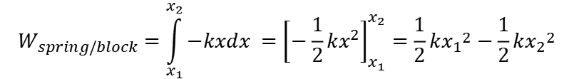
Ex. Work done by the spring force (5 minutes)
$$\vec{r}$$
Infinitesimal work done by the spring on the block during its displacement $\vec{r}$ is:
$$dW={\vec{F}}_{spring}.d\vec{r}=−kxdx$$
The work done by the spring on the block during its displacement from $x_{1}$ to $x_{2}$ is:
$$W_{spring/block}=\int_{x_{1}}^{x_{2}}{−kxdx }={\left[−\frac{1}{2}kx^{2}\right]}_{x_{1}}^{x_{2}}=\frac{1}{2}k{x_{1}}^{2}−\frac{1}{2}k{x_{2}}^{2}$$
Notes:
PARLER LENTEMENT: Then, to describe the work done by the spring force, we have to sum all the infinitesimal worl, and finnaly we obtain a function of the spring constant k and the x coordinate x 1 and x 2.

Slide 72


Ex. Work done by the spring force (5 minutes)
$$\vec{r}$$
The work done by the spring on the block during its displacement from $x_{1}$ to $x_{2}$ is:
$$W_{spring/block}=\frac{1}{2}k{x_{1}}^{2}−\frac{1}{2}k{x_{2}}^{2}$$
The work done by the block on the spring during its displacement from $x_{1}$ to $x_{2}$ is:
$$W_{block/spring}=\frac{1}{2}k{x_{2}}^{2}−\frac{1}{2}k{x_{1}}^{2}$$
Notes:
PARLER LENTEMENT: About the work done by the block on the spring, it is simply minus the work done by the spring force on the block. This is because of the Newton third low. The forces exerted by the spring on the block and by the block and the spring have opposite directions and same magnitude.

Slide 73
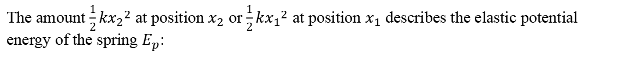
The elastic potential energy
The work done by the block on the spring during its displacement from $x_{1}$ to $x_{2}$ is:
$$W_{block/spring}=\frac{1}{2}k{x_{2}}^{2}−\frac{1}{2}k{x_{1}}^{2}$$
The amount $\frac{1}{2}k{x_{2}}^{2}$ at position $x_{2}$ or $\frac{1}{2}k{x_{1}}^{2}$ at position $x_{1}$ describes the elastic potential energy of the spring $E_{p}$:
Notes:
PARLER LENTEMENT: In this equation, you can see that the work done by the block and the spring correspond to a change of potential energy.

Slide 74

The elastic potential energy
The work done by the block on the spring during its displacement from $x_{1}$ to $x_{2}$ is:
$$W_{block/spring}=\frac{1}{2}k{x_{2}}^{2}−\frac{1}{2}k{x_{1}}^{2}$$
The amount $\frac{1}{2}k{x_{2}}^{2}$ at position $x_{2}$ or $\frac{1}{2}k{x_{1}}^{2}$ at position $x_{1}$ describes the elastic potential energy of the spring $E_{p}$:
$$E_{p}=\frac{1}{2}kx^{2}$$
Important to remember
where $x$ is the displacement from equilibrium position.
Notes:
PARLER LENTEMENT: Where the potential energy is the half of the spring constant multiplied by the distance from the equilibrium position. As for the kinetic energy, the elastic potential energy is important to remember.

Slide 75

The elastic potential energy
The elastic potential energy of the spring can increase or decrease by the intermediate of the force exerted by the spring on the block.
The work done by the spring on the block during its displacement from $x_{1}$ to $x_{2}$ is:
$$W_{spring/block}=\frac{1}{2}k{x_{1}}^{2}−\frac{1}{2}k{x_{2}}^{2}$$
$$W_{spring/block}=−∆E_{p }$$
where $∆E_{p,}=E_{p,2}−E_{p,1}$ is the change of elastic potential energy
Notes:
PARLER LENTEMENT: The elastic potential energy increase or decrease because of the spring force exerted on the block. And the work done the spring force on the block is minus its change of elastic potential energy.

Slide 76
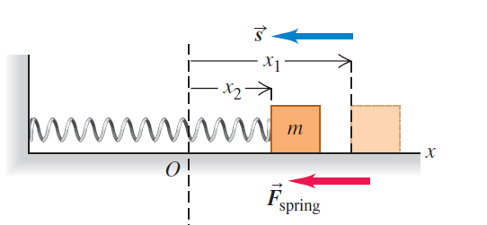
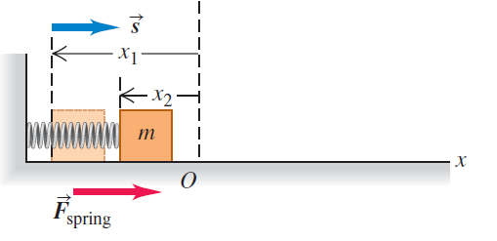
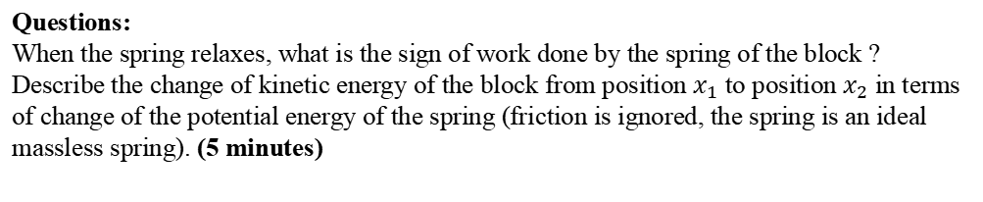


The elastic potential energy
The spring relaxes from position $x_{1}$ to $x_{2}$ (we let it to move freely)
The spring relaxes from position $x_{1}$ to $x_{2}$ (we let it to move freely)
Questions:
When the spring relaxes, what is the sign of work done by the spring of the block ?
Describe the change of kinetic energy of the block from position $x_{1}$ to position $x_{2}$ in terms of change of the potential energy of the spring (friction is ignored, the spring is an ideal massless spring). (5 minutes)
Notes:
PARLER LENTEMENT: What is about the change of kinetic energy ? Please to describe in that situation the change of kinetic energy of the block in terms of change of elastic potential energy. You have to use the work-kinetic energy theorem, and describe what is the work done by the net force on the block. Take care that we consider here there is no friction force. But first, please to describe the sign of the work in the both situations described, when the spring relaxes from position x1 to position x2.

Slide 77

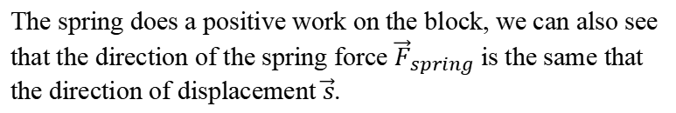

The elastic potential energy
Questions:
When the spring relaxes, what is the sign of work done by the spring of the block ?
$$W_{spring/block}=−∆E_{p }=\frac{1}{2}k{x_{1}}^{2}−\frac{1}{2}k{x_{2}}^{2}$$
$$W_{spring/block}>0$$
The spring does a positive work on the block, we can also see that the direction of the spring force ${\vec{F}}_{spring}$ is the same that the direction of displacement $\vec{s}$.
Notes:
PARLER LENTEMENT: We have described the work done by the spring on the block and x1 is greater than x2. So, the work done by the spring on the block between two positions is positive. Here the spring force help the motion.

Slide 78


The elastic potential energy
The work done by the spring on the block is:
$$W_{spring/block}=\frac{1}{2}k{x_{1}}^{2}−\frac{1}{2}k{x_{2}}^{2}=−∆E_{p }$$
The change of kinetic energy $∆E_{k}=E_{k,2}−E_{k,1}$ of the block equals the total work done on the block (work-kinetic energy theorem)
$$W_{tot}=∆E_{k}=E_{k,2}−E_{k,1}$$
Notes:
PARLER LENTEMENT: We have described the work done by the spring on the block. And because of the work-kinetic energy theorem, we know that the total work done by the forces exerted on the block is the change of its kinetic energy.

Slide 79

The elastic potential energy
The work done by the spring on the block is:
$$W_{spring/block}=\frac{1}{2}k{x_{1}}^{2}−\frac{1}{2}k{x_{2}}^{2}=−∆E_{p }$$
The change of kinetic energy $∆E_{k}=E_{k,2}−E_{k,1}$ of the block equals the total work done on the block (work-kinetic energy theorem)
$$W_{tot}=∆E_{k}=E_{k,2}−E_{k,1}$$
If there is no friction, the spring force is the only force which do work on the block is the spring force (weight and normal force are perpendicular to the displacement, they don’t do work)
$$W_{spring/block}=W_{tot}$$
Notes:
PARLER LENTEMENT: There is no friction, and the weight and the normal force are perpendicular to the displacement of the block, so only the spring force does work on the block. The work done by the spring force on the block is also the total work.

Slide 80


The elastic potential energy
The work done by the spring on the block is:
$$W_{spring/block}=\frac{1}{2}k{x_{1}}^{2}−\frac{1}{2}k{x_{2}}^{2}=−∆E_{p }$$
The change of kinetic energy $∆E_{k}=E_{k,2}−E_{k,1}$ of the block equals the total work done on the block (work-kinetic energy theorem)
$$W_{tot}=∆E_{k}=E_{k,2}−E_{k,1}$$
If there is no friction, the spring force is the only force which do work on the block is the spring force (weight and normal force are perpendicular to the displacement, they don’t do work)
$$W_{spring/block}=W_{tot}$$
$E_{k,2}−E_{k,1}$=$E_{p,1}−E_{p,2}$
$E_{k,2}+E_{p,2}$=$E_{k,1}+E_{p,1}$
Notes:
PARLER LENTEMENT: We obtain an expression between the change of the kinetic energy and the change of potential energy. From this expression, you can see we can put at the left the kinetic energy + the potential energy at position x 2 this sum is equal to the kinetic energy plus the potential energy at position x1. Take care that this result is because we have considered there was no friction force on the block.

Slide 81
The elastic potential energy
The work done by the spring on the block is:
$$W_{spring/block}=\frac{1}{2}k{x_{1}}^{2}−\frac{1}{2}k{x_{2}}^{2}=−∆E_{p }$$
The change of kinetic energy $∆E_{k}=E_{k,2}−E_{k,1}$ of the block equals the total work done on the block (work-kinetic energy theorem)
$$W_{tot}=∆E_{k}=E_{k,2}−E_{k,1}$$
If there is no friction, the spring force is the only force which do work on the block is the spring force (weight and normal force are perpendicular to the displacement, they don’t do work)
$$W_{spring/block}=W_{tot}$$
$E_{k,2}−E_{k,1}$=$E_{p,1}−E_{p,2}$
$E_{k,2}+E_{p,2}$=$E_{k,1}+E_{p,1}$
Warning: take care that this relation is not strictly right, a part of the elastic potential energy of the spring is converted in its kinetic energy and we have considered there is no friction (which never appears, there is always friction)
Notes:
PARLER LENTEMENT: And this is the relation is not strictly right if we do the experiment, because there is always friction. Also, we have considered a massless spring, but in a real situation, the spring has a mass, and a part of potential energy is converted in kinetic energy of the spring.

Slide 82
The gravitational potential energy
Notes:
PARLER LENTEMENT: We have described the elastic potential energy involved in a spring-mass system. Let’s to describe the gravitational potential energy associated with the gravitational force.

Slide 83
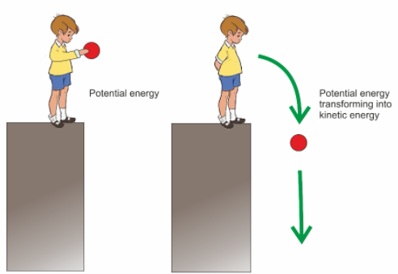



Introduction
$$y$$
$$y_{1}$$
$$\vec{s}$$
$$y_{2}$$
$$y=0$$
A ball of mass m is freely falling downward. We want to describe the work done by the gravitational force form position $y_{1}$ to position $y_{2}$.
Notes:
PARLER LENTEMENT: The boy is holding a ball and then let to fall on the ground. Before to fall, the ball has a certain potential energy we want to describe. Then the ball falls from position y 1 to position y 2, which correspond to the displacement s. First, we want to describe what is the work done by the gravitational force on the ball between these positions.

Slide 84


Introduction
Weight (gravitational force) exerted on the ball:
$$y$$
$$\vec{w}=m\vec{g}$$
$$y_{1}$$
$$\vec{s}$$
$$y_{2}$$
$$\vec{w}=m\vec{g}$$
$$y=0$$
Notes:
PARLER LENTEMENT: We know the expression of the weight exerted on the ball.

Slide 85
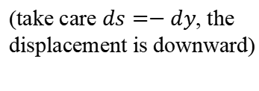

Introduction
Weight (gravitational force) exerted on the ball:
$$y$$
$$\vec{w}=m\vec{g}$$
Infinitesimal work done by the weight
$$dW=\vec{w}.d\vec{s}=−mgdy$$
(take care $ds=−dy$, the displacement is downward)
$$y_{1}$$
$$\vec{s}$$
$$y_{2}$$
$$\vec{w}=m\vec{g}$$
$$y=0$$
Notes:
PARLER LENTEMENT: Then, we describe the infinitesimal work done by the weight on the ball. Take of the minus sign here. The y-axis is directed upward but the displacement is directed downward. Thus, the infinitesimal displacement ds is minus dy.

Slide 86
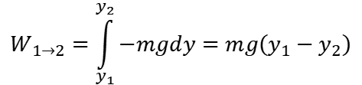
Introduction
Weight (gravitational force) exerted on the ball:
$$y$$
$$\vec{w}=m\vec{g}$$
Infinitesimal work done by the weight
$$dW=\vec{w}.d\vec{s}=−mgdy$$
(take care $ds=−dy$, the displacement is downward)
$$y_{1}$$
$$W_{1→2}=\int_{y_{1}}^{y_{2}}{−mgdy}=mg\left(y_{1}−y_{2}\right)$$
$$\vec{s}$$
(we could also simply use the expression of the work of a constant force during a straight line displacement)
$$y_{2}$$
$$\vec{w}=m\vec{g}$$
$$y=0$$
Notes:
PARLER LENTEMENT: Then we obtain the work done by the weight. Here the weight is a constant force and the displacement a straight line, so another possibility could be to use the expression of the work in this particular case. We have described the work done by the gravitational force, we can describe the associated potential energy.

Slide 87

The gravitational potential energy
The work done by the weight on the ball from $y_{1}$ to $y_{2}$ is:
$$W_{1→2}=mg\left(y_{1}−y_{2}\right)=−∆E_{p}$$
where $∆E_{p}=E_{p,2}−E_{p,1}$ is the change of potential energy of the ball (which is converted in kinetic energy when the ball is falling)
The gravitational potential energy is:
$$E_{p}=mgy$$
height
Mass of the ball
Gravitational acceleration
Notes:
PARLER LENTEMENT: The work done by the weight on the ball is minus its change of potential energy. Then, we can describe the potential energy as follows. It is the product between the mass of the ball, the gravitational acceleration and the y-coordinate of the ball.

Slide 88


The gravitational potential energy
The work done by the weight on the ball from $y_{1}$ to $y_{2}$ is:
$$W_{1→2}=−∆E_{p}=E_{p,1}−E_{p,2}$$
If only the gravitational force does work on the ball (the friction with air is ignored):
$$W_{1→2}=−∆E_{p}=W_{tot}$$
Notes:
PARLER LENTEMENT: Here also, we can see how are related the change of potential energy and the change of kinetic energy. The work done by the weight on the ball is minus the change of its gravitational potential energy. And in this example, the work done by the weight is also the total work, if we ignore the friction between the ball and air.

Slide 89

The gravitational potential energy
The work done by the weight on the ball from $y_{1}$ to $y_{2}$ is:
$$W_{1→2}=−∆E_{p}=E_{p,1}−E_{p,2}$$
If only the gravitational force does work on the ball:
$$W_{1→2}=−∆E_{p}=W_{tot}$$
And the total work done on the ball is also the change of kinetic energy of the ball (work-kinetic energy theorem)
$$W_{tot}=E_{k,2}−E_{k,1}=∆E_{k}$$
Notes:
PARLER LENTEMENT: And we can apply the work-kinetic energy theorem, the total work done on the ball is the change of its kinetic energy.

Slide 90


The gravitational potential energy
The work done by the weight on the ball from $y_{1}$ to $y_{2}$ is:
$$W_{1→2}=−∆E_{p}=E_{p,1}−E_{p,2}$$
If only the gravitational force does work on the ball:
$$W_{1→2}=−∆E_{p}=W_{tot}$$
And the total work done on the ball is also the change of kinetic energy of the ball (work-kinetic energy theorem)
$$W_{tot}=E_{k,2}−E_{k,1}=∆E_{k}$$
$$E_{k,2}−E_{k,1}=E_{p,1}−E_{p,2}$$
$$E_{k,1}+E_{p,1}=E_{k,2}+E_{p,2}$$
Notes:
PARLER LENTEMENT: We obtain that the change of kinetic energy is minus the change of the gravitational potential energy. As before the kinetic energy + the potential energy at the initial position is the kinetic energy + the potential energy at the final position.

Slide 91
The gravitational potential energy
The work done by the weight on the ball from $y_{1}$ to $y_{2}$ is:
$$W_{1→2}=−∆E_{p}=E_{p,1}−E_{p,2}$$
If only the gravitational force does work on the ball:
$$W_{1→2}=−∆E_{p}=W_{tot}$$
And the total work done on the ball is also the change of kinetic energy of the ball (work-kinetic energy theorem)
$$W_{tot}=E_{k,2}−E_{k,1}=∆E_{k}$$
$$E_{k,2}−E_{k,1}=E_{p,1}−E_{p,2}$$
$$E_{k,1}+E_{p,1}=E_{k,2}+E_{p,2}$$
Warning: The conservation of the energy $E_{p}+E_{k}$ is only possible because we have considered there is no friction, but there is always friction.
Notes:
PARLER LENTEMENT: But take care because there is conservation of the potential energy plus the kinetic energy because we have ignored the friction. But there is always friction.

Slide 92

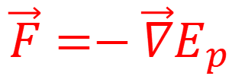



Conservative forces and potential energy
A conservative force $\vec{F}$is associated with a potential energy. Not all the forces are conservative forces.
$$\vec{F}=−\vec{∇}E_{p}$$
Important to remember
$$F_{x}=−\frac{∂E_{p}}{∂x}$$
$$F_{y}=−\frac{∂E_{p}}{∂y}$$
$$F_{z}=−\frac{∂E_{p}}{∂z}$$
A conservative force is the negative of the gradient of the potential energy $\vec{∇}E_{p}$ associated with this force.
This expression permits to describe the conservative force from the potential energy.
To describe the potential energy from the conservative force you must to use:
$$\vec{F}.d\vec{r}=−dE_{p}$$
Notes:
PARLER LENTEMENT:

Slide 93
Conservative forces and potential energy
A conservative force $\vec{F}$is associated with a potential energy. Not all the forces are conservative forces.
$$F_{x}=−\frac{∂E_{p}}{∂x}$$
$$F_{y}=−\frac{∂E_{p}}{∂y}$$
$$F_{z}=−\frac{∂E_{p}}{∂z}$$
Important to remember
Notes:
PARLER LENTEMENT: As you have seen gravitational force and spring force are related with gravitational potential energy and elastic potential energy. These forces are named conservative forces. A conservative force is associated with a kind of potential energy. The relation between the conservative force and the associated potential energy is as follows. The conservative force is minus the gradient of the associated potential energy. Here are the relation between the x, y and z-component of the conservative force and the x, y, and z-partial derivative of the associated potential energy.

Slide 94
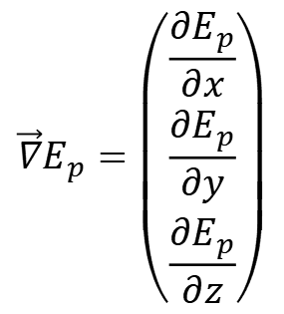

Conservative forces and potential energy
For a conservative force $\vec{F}$i.e. associated with a potential energy (not all the forces are conservative forces):
$$F_{x}=−\frac{∂E_{p}}{∂x}$$
$$F_{y}=−\frac{∂E_{p}}{∂y}$$
$$F_{z}=−\frac{∂E_{p}}{∂z}$$
Important to remember
$$\vec{∇}=\left(\begin{matrix}\frac{∂}{∂x} \\ \frac{∂}{∂y} \\ \frac{∂}{∂z}\end{matrix}\right)$$
$$\vec{∇}E_{p}=\left(\begin{matrix}\frac{∂E_{p}}{∂x} \\ \frac{∂E_{p}}{∂y} \\ \frac{∂E_{p}}{∂z}\end{matrix}\right)$$
Operator “Nabla”:
Gradient of the potential energy
Notes:
PARLER LENTEMENT: Or, instead of 3 equations, we could describe only one equation. For that we will use the nabla operator.The nabla operator has 3 components describing the x,y and z partial derivative. If we put the potential energy after the nabla operator, we obtain a vector which the components are the x, y and z-partial derivative of the potential energy. This vector is named “the gradient of the potential energy”.

Slide 95

Conservative forces and potential energy
For a conservative force $\vec{F}$i.e. associated with a potential energy (not all the forces are conservative forces):
$$F_{x}=−\frac{∂E_{p}}{∂x}$$
$$F_{y}=−\frac{∂E_{p}}{∂y}$$
$$F_{z}=−\frac{∂E_{p}}{∂z}$$
Important to remember
$$\vec{∇}=\left(\begin{matrix}\frac{∂}{∂x} \\ \frac{∂}{∂y} \\ \frac{∂}{∂z}\end{matrix}\right)$$
$$\vec{∇}E_{p}=\left(\begin{matrix}\frac{∂E_{p}}{∂x} \\ \frac{∂E_{p}}{∂y} \\ \frac{∂E_{p}}{∂z}\end{matrix}\right)$$
Operator “Nabla”:
$$\vec{F}=−\vec{∇}E_{p}$$
Important to remember
Notes:
PARLER LENTEMENT: And the conservative force associated with a potential energy is minus the gradient of the associated potential energy. This equation have the same meaning than the 3 equations at the top. You have to remember all of them, but in exercise, you can choose which one you prefer to use.

Slide 96


Work done by conservative forces
$$W_{cons }=−∆E_{p}$$
The work done by a conservative force exerted on a body is the negative of the change of its potential energy.
If the conservative force don’t do work, the potential energy remains constant (example: work of the weight during an horizontal motion)
$$∆E_{p}=0$$
Notes:
PARLER LENTEMENT: The other kind of relationship between a conservative force and the associated potential energy is that the work done by the conservative force is minus the change of potential energy. This means that if the conservative force don’t do work, the associated potential energy don’t change, it stays constant.

Slide 97



Work done by conservative forces
$$W_{cons }=−∆E_{p}$$
The work done by a conservative force exerted on a body is the negative of the change of its potential energy.
If the conservative force don’t do work, the potential energy remains constant (example: work of the weight during an horizontal motion)
$$∆E_{p}=0$$
The work done by a conservative force don’t depends on the path travelled.
$$path 1$$
A
$$path 2$$
SAME WORK (if the force is a conservative force)
B
$$path 3$$
Notes:
PARLER LENTEMENT: A result of this property is that the work done by a conservative force don’t depends on the path travelled by the body in motion. Here is an example with 3 paths between points A and B. A body moves from A to B. The work done by a conservative force is the same for these three paths. This property could be useful when we want to describe the work by a conservative force. We just have to choose one path where it is easy to describe.

Slide 98
The mechanical energy: introduction
The spring force and the gravitational force are named “conservative forces”. A change of potential energy result in a change of kinetic energy.
Notes:
PARLER LENTEMENT: As you have seen, the spring force and the gravitational force are associated with a kind of potential energy. We say they are conservative forces. And a change of potential energy results in a change of kinetic energy by the intermediate of the conservative forces exerted on the body.

Slide 99

The mechanical energy: introduction
The spring force and the gravitational force are named “conservative forces”. A change of potential energy result in a change of kinetic energy.
The work done by the conservative forces $W_{cons}$ is:
$$W_{cons}=−∆E_{p}$$
where $∆E_{p}$ is the change of potential energy.
Notes:
PARLER LENTEMENT: In equation, the work done by the conservative forces is minus the change of the associated potential energy.

Slide 100

The mechanical energy: introduction
The spring force and the gravitational force are named “conservative forces”. A change of potential energy result in a change of kinetic energy.
The work done by the conservative forces $W_{cons}$ is:
$$W_{cons}=−∆E_{p}$$
where $∆E_{p}$ is the change of potential energy.
The work done by all the forces is (work-kinetic energy theorem):
$$W_{tot}=∆E_{k}$$
Notes:
PARLER LENTEMENT: And we have described the work-energy theorem. Take care that the work done by conservative forces is not the total work, because there are forces which are not conservatives, for instance the friction force.

Slide 101

The mechanical energy: introduction
The spring force and the gravitational force are named “conservative forces”. A change of potential energy result in a change of kinetic energy.
The work done by the conservative forces $W_{cons}$ is:
$$W_{cons}=−∆E_{p}$$
where $∆E_{p}$ is the change of potential energy.
The work done by all the forces is (work-kinetic energy theorem):
$$W_{tot}=∆E_{k}$$
If all the forces which do work are conservative forces, then:
$$W_{tot}=W_{cons}$$
Notes:
PARLER LENTEMENT: But if all the forces which do work on a body are conservative forces then the work done by conservative forces is also the total work.

Slide 102


The mechanical energy: introduction
The spring force and the gravitational force are named “conservative forces”. A change of potential energy result in a change of kinetic energy.
The work done by the conservative forces $W_{cons}$ is:
$$W_{cons}=−∆E_{p}$$
where $∆E_{p}$ is the change of potential energy.
The work done by all the forces is (work-kinetic energy theorem):
$$W_{tot}=∆E_{k}$$
If all the forces which do work are conservative forces, then:
$$W_{tot}=W_{cons}$$
$${∆E}_{k}+∆E_{p}=0$$
$${∆(E}_{k}+E_{p})=0$$
Notes:
PARLER LENTEMENT: And in that case, the change of kinetic energy plus the change of potential energy equals zero. Or we can say that the change of the sum of kinetic energy plus potential energy equals zero. You can see that the sum of these both kinds of energy is meaning full in physics.

Slide 103


The mechanical energy
Expression of the mechanical energy $E_{m}$ of a body:
$$E_{m}=E_{k}+E_{p}$$
Important to remember
where:
$E_{k}$ is the kinetic energy of the body
$E_{p}$ is the potential energy of the body which depends to which forces does work on the body, If both spring force and gravitational forces do work, then,
Notes:
PARLER LENTEMENT: The sum of the kinetic energy + the potential energy is named the mechanical energy of the body. In this equation, E_k is the kinetic energy and E_p is the potential energy. We have described two kinds of potential energy. And a body could be submitted to gravitational forces and elastic forces.

Slide 104


The mechanical energy
Expression of the mechanical energy $E_{m}$ of a body:
$$E_{m}=E_{k}+E_{p}$$
Important to remember
where:
$E_{k}$ is the kinetic energy of the body
$E_{p}$ is the potential energy of the body which depends to which forces does work on the body, If both spring force and gravitational forces do work, then,
$$E_{p}=E_{p,el}+E_{p,grav}$$
Elastic potential energy
Gravitational potential energy
Notes:
PARLER LENTEMENT: In that situation the potential energy is simply the some of each kind of potential energy.

Slide 105

The mechanical energy
Expression of the mechanical energy $E_{m}$ of a body:
$$E_{m}=E_{k}+E_{p}$$
Important to remember
where:
$E_{k}$ is the kinetic energy of the body
$E_{p}$ is the potential energy of the body which depends to which forces does work on the body, If both spring force and gravitational forces do work, then,
$$E_{p}=E_{p,el}+E_{p,grav}$$
There is potential energy associated with other kind of conservative forces, which will be described later
Notes:
PARLER LENTEMENT: There are others kinds of potential energy, and I will describe them later.

Slide 106

The mechanical energy
Expression of the mechanical energy $E_{m}$ of a body:
$$E_{m}=E_{k}+E_{p}$$
Important to remember
where:
$E_{k}$ is the kinetic energy of the body
$E_{p}$ is the potential energy of the body which depends to which forces does work on the body, If both spring force and gravitational forces do work, then,
$$E_{p}=E_{p,el}+E_{p,grav}$$
There is potential energy associated with other kind of conservative forces, which will be described later
${∆E}_{m}=∆(E_{k}+E_{p})$ is a change of mechanical energy of a body
Notes:
PARLER LENTEMENT: The change of mechanic energy is describe by this equation. If only conservative forces do work on a body, this change of mechanical energy equals 0, the mechanical energy don’t change and stay constant during the motion.

Slide 107

The change of mechanical energy
However, the friction have been ignored. The friction forces are named “non-conservative forces”. Other example of non-conservative force is the force done by the hand on the block attached to the spring.
hand pushing the block
friction of block on table
Notes:
PARLER LENTEMENT: However, in the previous exercise we have ignored the friction. The friction is a non-conservative force. There is no potential energy associated with the friction force. Another example in this example is the force exerted by the hand on the block. This force is also-non conservative.

Slide 108

The change of mechanical energy
However, the friction have been ignored. The friction forces are “non-conservative forces”. Other example of non-conservative force is the force done by the hand on the block attached to the spring.
hand pushing the block
friction of block on table
These forces does the work $W_{other}$ and the total work done by all the forces is:
$$W_{tot}=W_{cons}+W_{other}$$
Notes:
PARLER LENTEMENT: The total work done on the block is the sum of the work done by the conservative forces and the work done by the non-conservative forces. I name the work done by the non-conservative forces W_other.

Slide 109


The change of mechanical energy
However, the friction have been ignored. The friction forces are “non-conservative forces”. Other example of non-conservative force is the force done by the hand on the block attached to the spring.
hand pushing the block
friction of block on table
These forces does the work $W_{other}$ and the total work done by all the forces is:
$$W_{tot}=W_{cons}+W_{other}$$
$$W_{cons}=−∆E_{p}$$
$$W_{tot}=∆E_{k}$$
Notes:
PARLER LENTEMENT: We know that the work done by the conservative forces is minus the change of the potential energy. And the total work is the change of kinetic energy.

Slide 110

The change of mechanical energy
However, the friction have been ignored. The friction forces are “non-conservative forces”. Other example of non-conservative force is the force done by the hand on the block attached to the spring.
hand pushing the block
friction of block on table
These forces does the work $W_{other}$ and the total work done by all the forces is:
$$W_{tot}=W_{cons}+W_{other}$$
$$W_{cons}=−∆E_{p}$$
$${∆E}_{k}+∆E_{p}=W_{other}$$
$$W_{tot}=∆E_{k}$$
Notes:
PARLER LENTEMENT: We deduce from these 3 equations that the change of kinetic energy + the change of potential energy is the work done by the non-conservative forces.

Slide 111


The change of mechanical energy
The change of mechanical energy of a body is the work done by the non-conservative forces on the body.
$$∆E_{m}=W_{other}$$
Important to remember
Take care that in a realistic situation, where a body is moving, there is always friction (friction with support of a pendulum, friction with table, friction with air etc.).
$$W_{friction}≠0$$
Notes:
PARLER LENTEMENT: To summary, we have demonstrated in the previous slide that the change of mechanical energy is also the work done by the non-conservative forces on a body. Take care that often we will imagine situation where the friction is ignored, but there is always friction, and this friction is always opposite to the motion.

Slide 112
Work and exchange of energy
Je peux prendre example en montrant de boule de papier lance en l’air
Work done by conservative forces:
Exchange of energy between kinetic energy and potential energy
Je peux prendre exemple friction des mains pour augmenter la temperature des mains
.
Notes:
PARLER LENTEMENT: The work is always a kind of transfer or exchange of energy. When conservative forces do work, there is exchange of energy between the kinetic energy of the body and its potential energy.

Slide 113
Work and exchange of energy
Work done by conservative forces:
Exchange of energy between kinetic energy and potential energy
Work done by non-conservative force:
Change of mechanical energy
So where come from the mechanical energy which is gained or where goes the mechanical energy which is lost by the body ?
Notes:
PARLER LENTEMENT: When non conservative forces do work on a body, it results in a change of its mechanical energy. So, this mechanical energy can increase or decrease. In that case, where come from the mechanical energy which is gained or where goes the mechanical energy which is lost by the body ?

Slide 114
Work and exchange of energy
Je peux prendre example en montrant de boule de papier lance en l’air
Work done by conservative forces:
Exchange of energy between kinetic energy and potential energy
Work done by non-conservative force:
Change of mechanical energy
So where come from the mechanical energy which is gained or where goes the mechanical energy which is lost by the body ?
Je peux prendre exemple friction des mains pour augmenter la temperature des mains
.
It result in terms of change of internal energy
Internal energy of a body is related with its temperature. We will described it in details later.
Notes:
PARLER LENTEMENT: The change of the mechanical energy of a body results in a change of its internal energy. The internal energy of a body depends to its temperature. I will not describe you now in details about what is the internal energy, but we will discuss about it later.

Slide 115


The law of conservation of energy
$$∆E_{m}=∆E_{k}+∆E_{p}=W_{other}$$
$$∆E_{k}+∆E_{p}−W_{other}=0$$
Notes:
PARLER LENTEMENT: We have seen the change of mechanical energy is the work done by the non-conservative forces. We can put this equation as follows. The change the kinetic energy plus the change of potential energy minus the work done by non-conservative forces equals zero.

Slide 116

The law of conservation of energy
$$∆E_{m}=∆E_{k}+∆E_{p}=W_{other}$$
$$∆E_{k}+∆E_{p}−W_{other}=0$$
$$∆E_{k}+∆E_{p}+∆U_{int}=0$$
law of conservation of energy（能量守恒定律）, to remember !
where
$∆U_{int}=−W_{other}$ is the change of internal energy of the body
Notes:
PARLER LENTEMENT: Or another form of this equation is as follows. The change of kinetic energy plus the change of potential energy + the change of internal energy equals zero, where delta_U is the change of internal energy of the body. This equation is named the law of conservation of energy.

Slide 117


The law of conservation of energy
$$∆E_{m}=∆E_{k}+∆E_{p}=W_{other}$$
$$∆E_{k}+∆E_{p}−W_{other}=0$$
$$∆E_{k}+∆E_{p}+∆U_{int}=0$$
law of conservation of energy, to remember !
where
$∆U_{int}=−W_{other}$ is the change of internal energy of the body
When a body interact with others by the intermediate of forces, its total energy ($E_{k}+E_{p}+U_{int}$) doesn’t change !
The amount of kinetic energy, potential energy and internal energy change.
This statement seems strange but it has been verified experimentally.
Notes:
PARLER LENTEMENT: When a body interact with other bodies by the intermediate of forces, its total energy doesn’t change. What change is the amount of kinetic energy, potential energy and internal energy depending to which forces exert a work on a body. This statement could seems strange, but it has been verified. So Lavoisier was right ! Energy is not created, it just change from one kind to another kind.

Slide 118







Summary of the lesson
Total work on a body is the change of kinetic energy.
$$W_{tot }= ∆E_{k}$$
Work of conservative forces is the negative of the change of potential energy associated
$$W_{cons}=−∆E_{p}$$
Conservative force is the negative of the gradient of potential energy associated
$$\vec{F}=−\vec{∇}E_{p}$$
Mechanical energy of a body
$$E_{m}=E_{k}+E_{p}$$
Change of mechanical energy of a body is the work of non-conservative forces
$${∆E}_{m}=W_{other}$$
The total energy of a body is always conserved
$$∆E_{k}+∆E_{p}+{∆U}_{int}=0$$
$U_{int}:$ internal energy
And of course, the expression of the spring force and the elastic potential energy, of the weight and the gravitational potential energy must be known.
Notes:
PARLER LENTEMENT: Here is a summary of the important things to remember about the lesson. First, the work-kinetic energy theorem. The work done by the conservative force is also minus the change of potential energy. Third, the relation between a conservative force and the gradient of the associated potential energy. And finally about the change mechanical energy and the conservation of the total energy.

Slide 119
End of the lesson, university physics – Mechanics 5
slides suivants a donner en homework, sauf si j’ai fini la lesson plus de 5 minutes avant la fin

